Slide 1
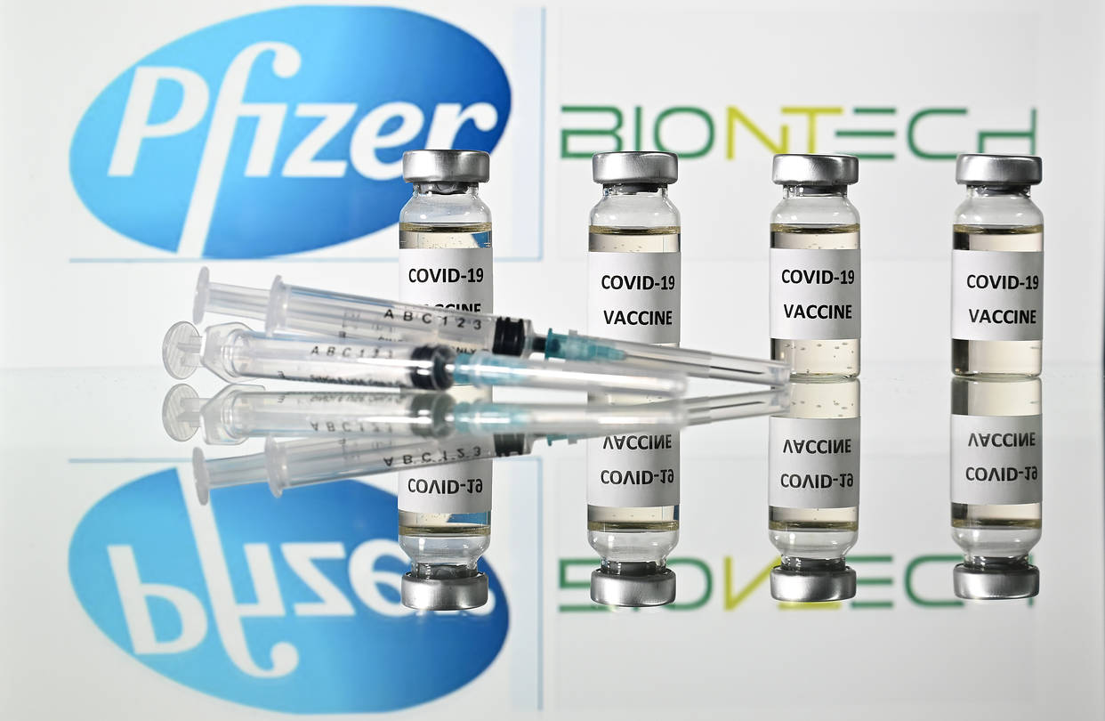
Evidence of Graphene Oxide in EUA ‘VACCINES’

Slide 2
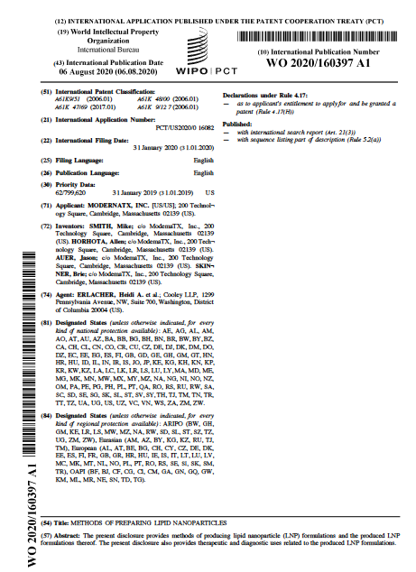

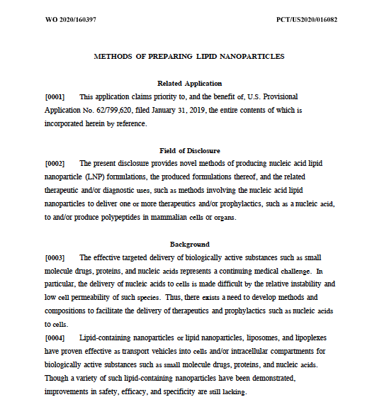
MODERNA/NIH WIPO 2020/160397, LNP Operating System

Slide 3
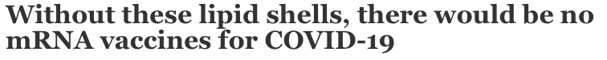
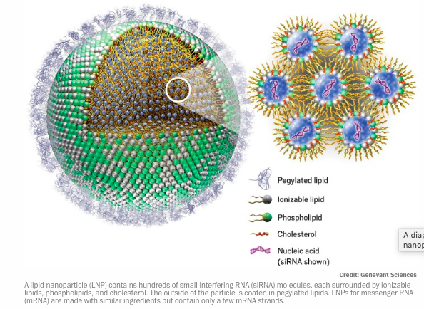

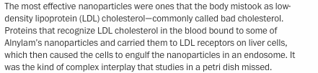
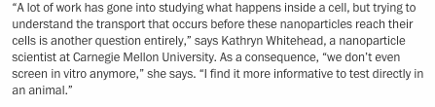


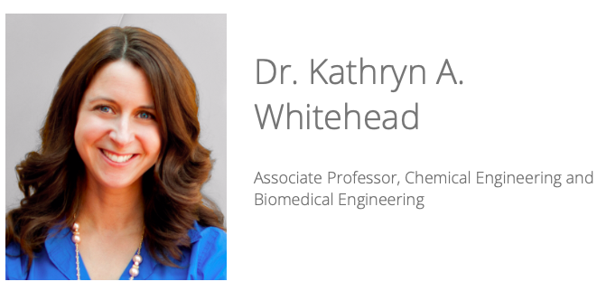
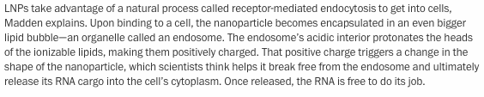
4 lipids
in LNPS
The PEGylated lipids contain graphene oxide. PEGylated LNPs are made by SINOPEG in China
https://cen.acs.org/pharmaceuticals/drug-delivery/Without-lipid-shells-mRNA-vaccines/99/i8

Slide 4
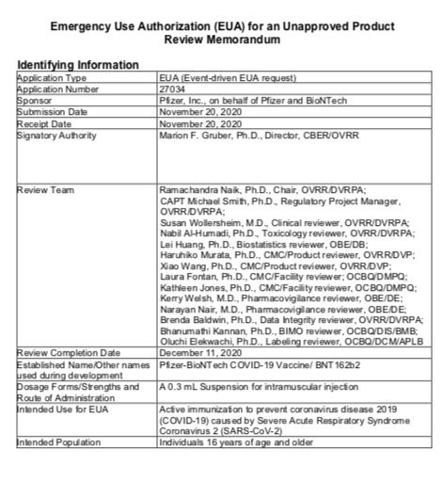
What’s in Pfizer BNT162b and COVID-19 Injections?
PFE EUA #27034, Nov 20, 2020, pg. 11
Sec. 3. Pfizer/BioNtech COVID019 Vaccine (BNT162b)
3.1 Vaccine Composition, Dosign Regimen
The vaccine contains a nucleoside-modified messenger RNA (modRNA) encoding the viral spike glycoprotein (S) of SARS-CoV-2. The vaccine also includes the following ingredients: lipids ((4-hydroxybutyl)azanediyl) bis (hexane-6,1-diyl)bis(2- hexyldecanoate), 2-[(polyethylene glycol)-2000]-N,N-ditetradecylacetamide, 1,2-distearoyl-sn- glycero-3-phosphocholine, and cholesterol), potassium chloride, monobasic potassium phosphate, sodium chloride, dibasic sodium phosphate dihydrate, and sucrose.
Two (2) PEGylated Lipids in Pfizer BNT162b2
ALC-0135 ∣ ALC-0159
https://www.fda.gov/media/144416/download

Slide 5
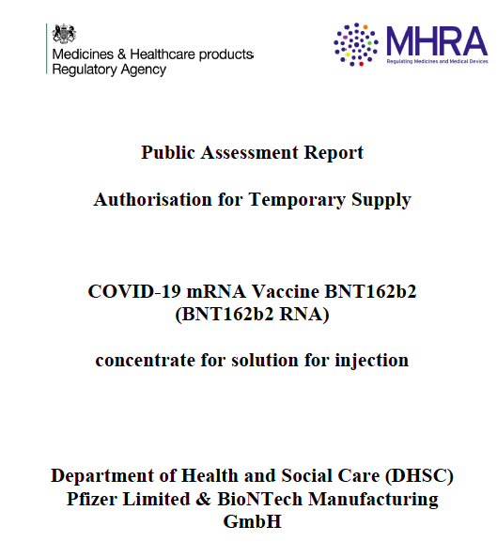
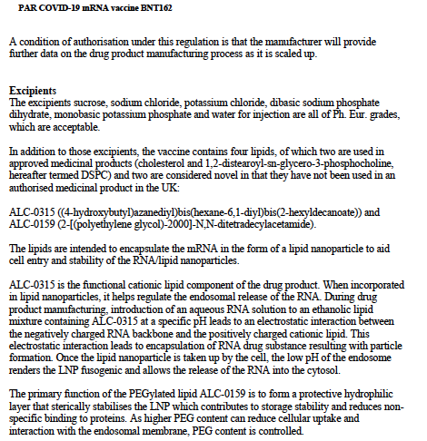
Pfizer/BioNtech BNT162b PEGs: ALC-0315 and ALC-0159

Slide 6
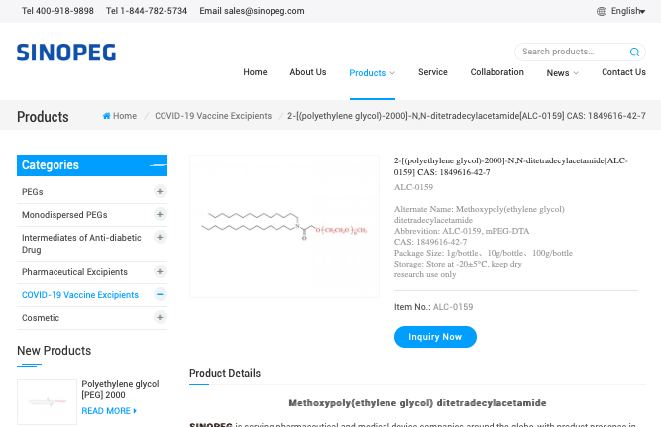

2-[(polyethylene glycol)-2000]-N,N-ditetradecylacetamide, 1,2-distearoyl-sn- glycero-3-phosphocholine, and cholesterol)

Slide 7
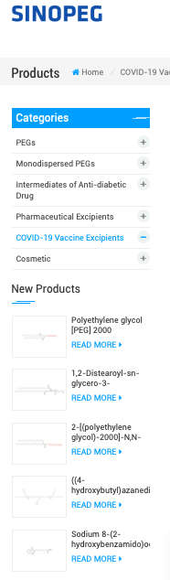
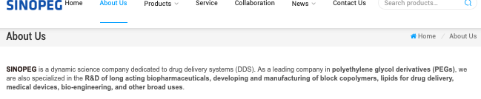
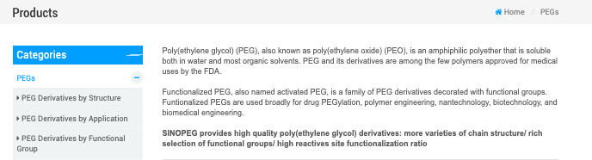
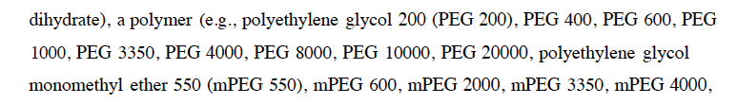
MODERNA/NIH WIPO
PAGE 41
MODERNA/NIH WIPO
PAGE 20 - (0119)

Slide 8
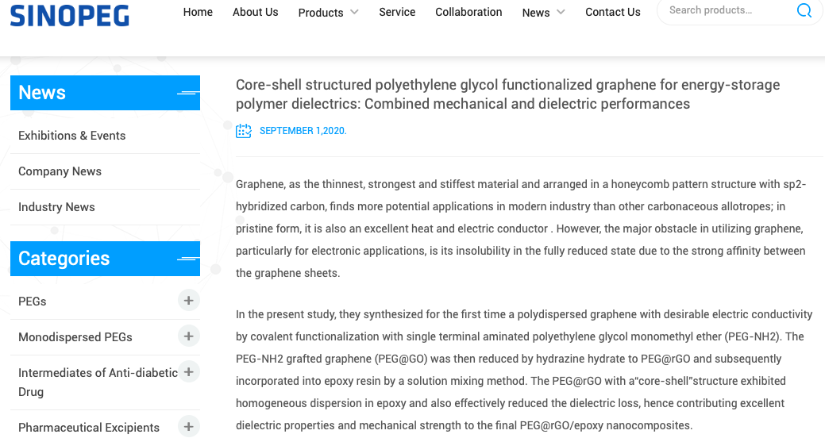

Slide 9
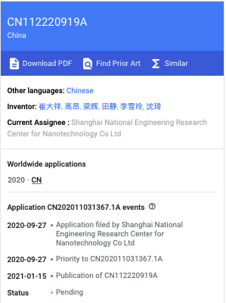
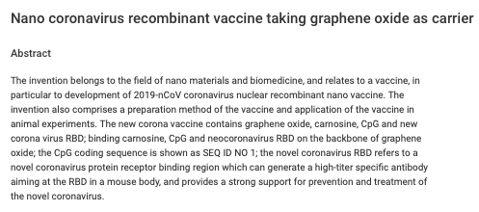
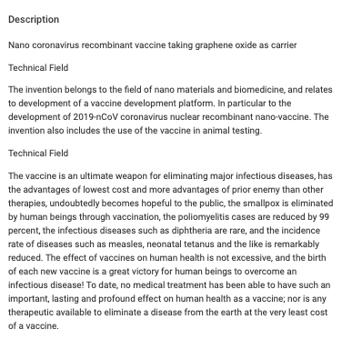
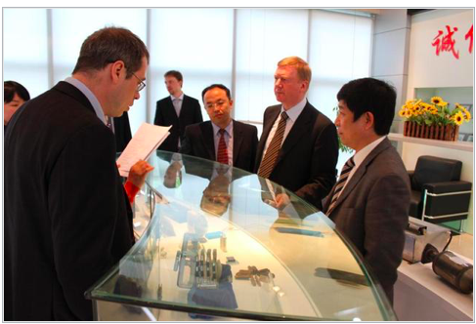
Global Patent for 2019-nCov Vaccines’ Graphene Lipid Nanotechnology
U.S. & Global Pharma & Biotech leaders meeting at Shanghai National Engineering Research Center for Nantotech to Collaborate on Global COVID-19 Vaccines
Photo directly from Shanghai National Eng Research Website
1. https://patents.google.com/patent/CN112220919A/en?oq=CN112220919A
2. https://en.sjtu.edu.cn/research/centers-labs/national-engineering-research-center-for-nanotechnology

Slide 10
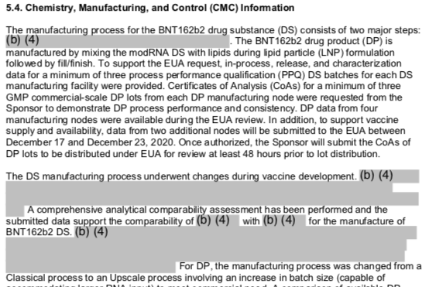
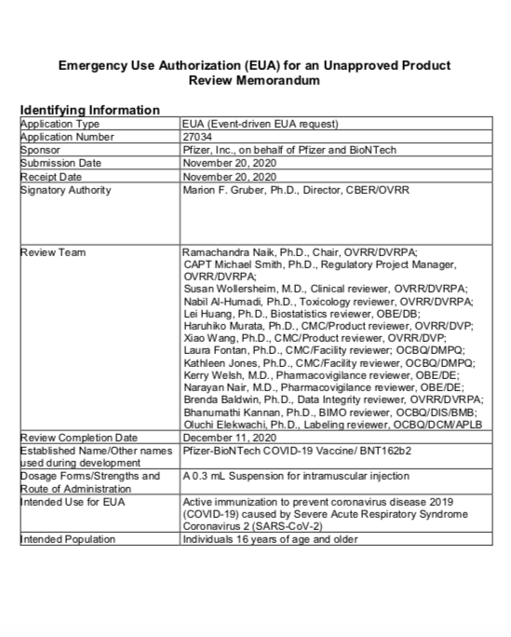

PFE cGMP Procedures and Inspections is Redacted, pgs. 47-48
https://www.fda.gov/media/144416/download

Slide 11
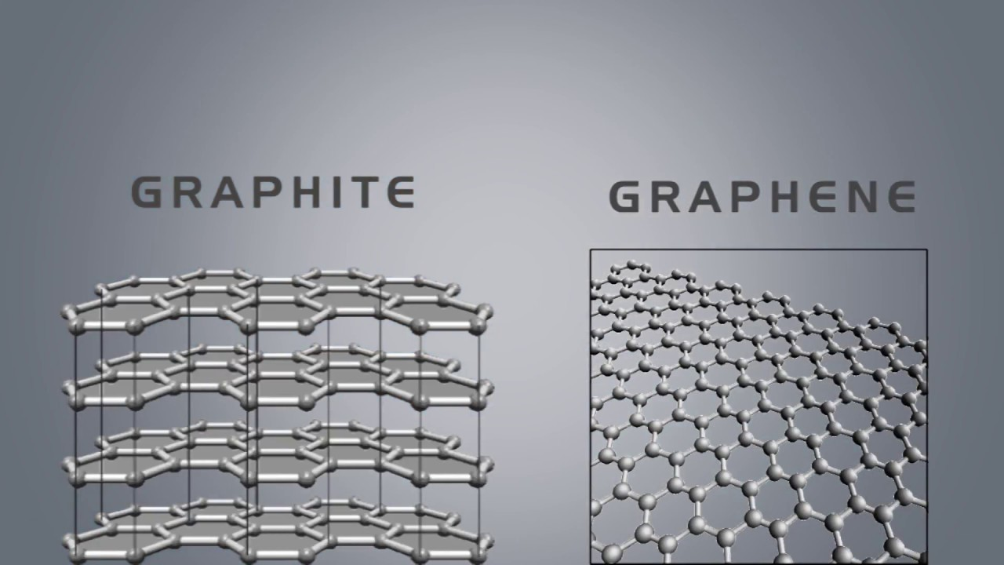
Why Choose Graphene Oxide as the Delivery System (excipient)?

Slide 12
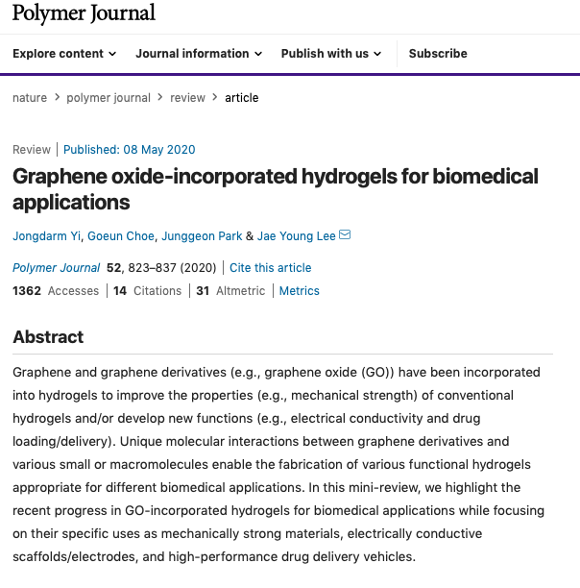
How Small are the PEGylated Lipid Nanoparticles?
Measurement Units
1mm = 1,000 μm (micrometer)
1 μm = 1,000 nm (nanometers)
Biological Examples:
Macrophage (WBC) = 21 μm = 21,000 nm
Red Blood Cell (RBC) = 6-8 μm = 6,000 – 8,000 nm
Platelet 2-4 μm = 2,000 – 4,000 nm
mRNA and RNA = 100’s nm
mRNA COV- Spike Protein = .35 nm
SARS-CoV-2 Respiratory Particles¹ 4.7 μm = 4,700 nm
PEGylated Lipid Nanoparticles² = 10’s to 100’s nm
The PEGylated LNP encapsulated mRNA is 40 nm 150 nm inside the ‘vaccines.’ Scientists have reduced the size of SARS-CoV-2 by up to 99.15% while improving the mRNA’s transmissibility, including its ability to withstand extremely harsh natural environments and natural human and mammalian defenses against viral infections.
https://www.nature.com/articles/s41428-020-0350-9

Slide 13
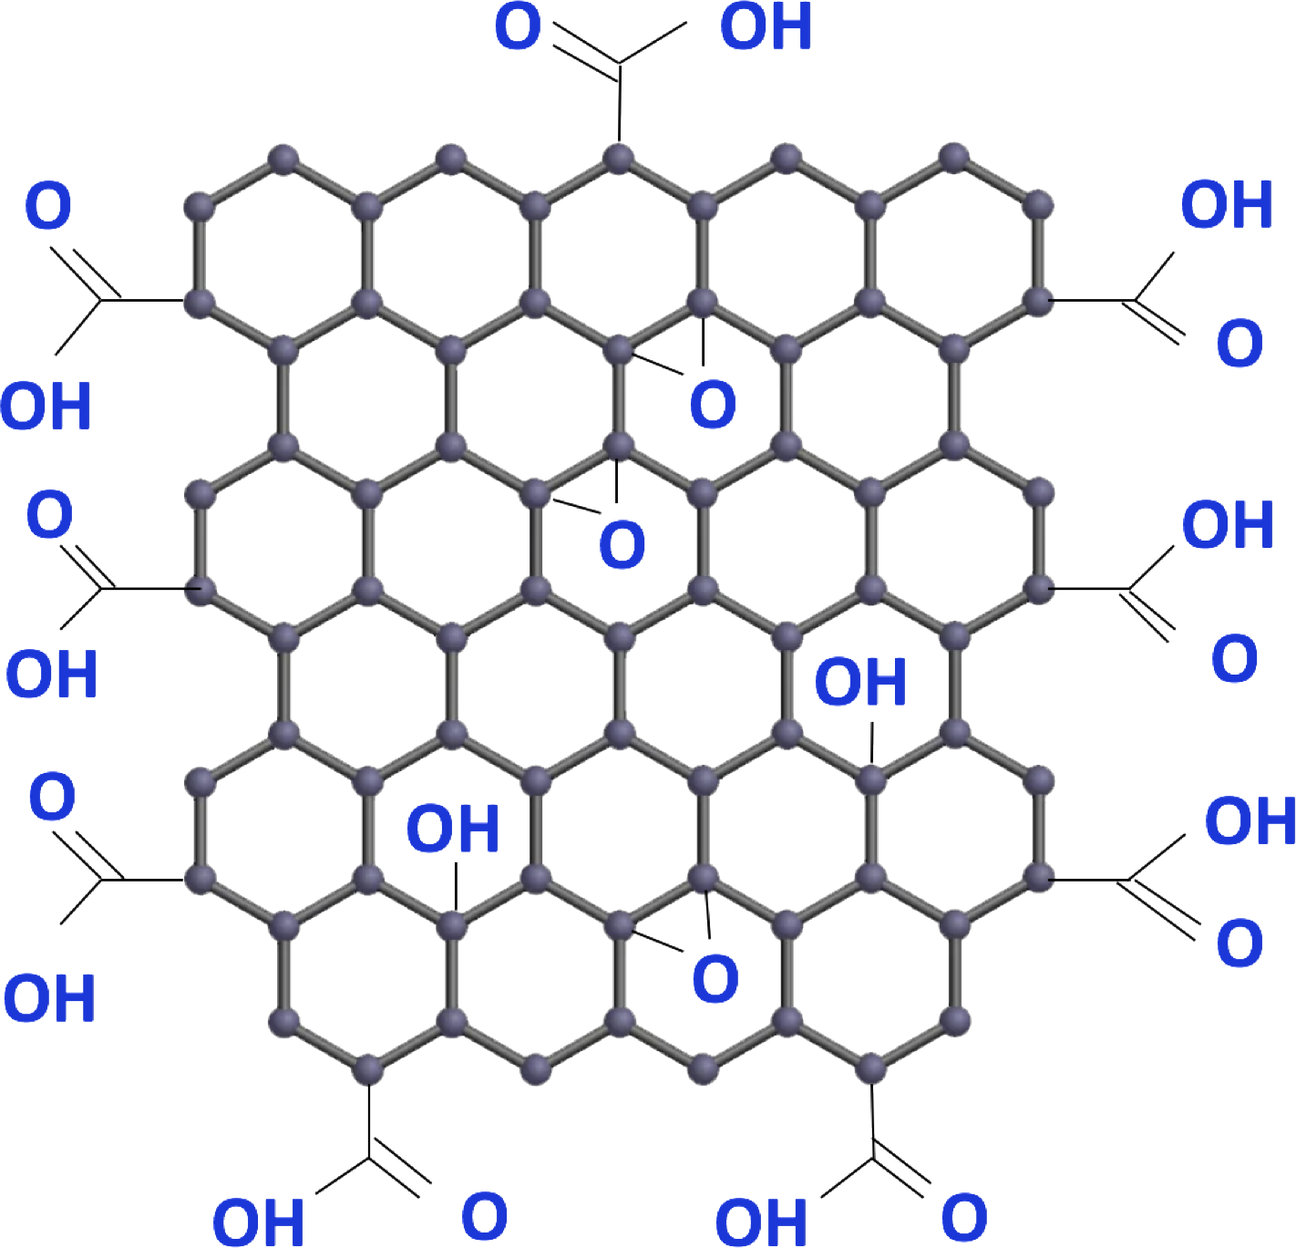
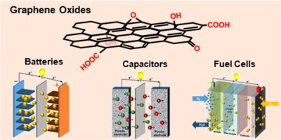
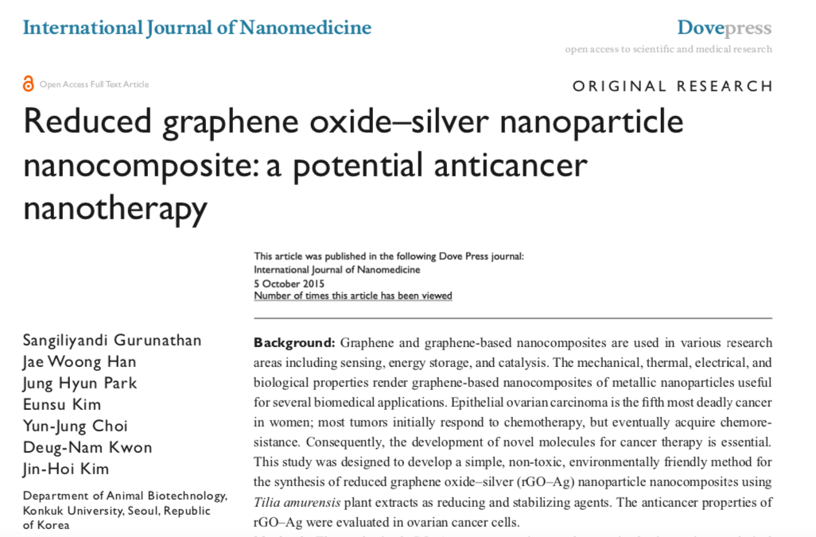
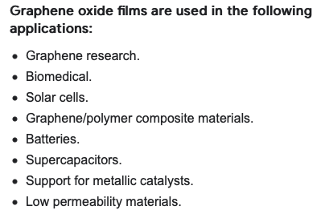
What is Graphene Oxide? What is it used for?
https://www.dovepress.com/getfile.php?fileID=27376

